Slide 1
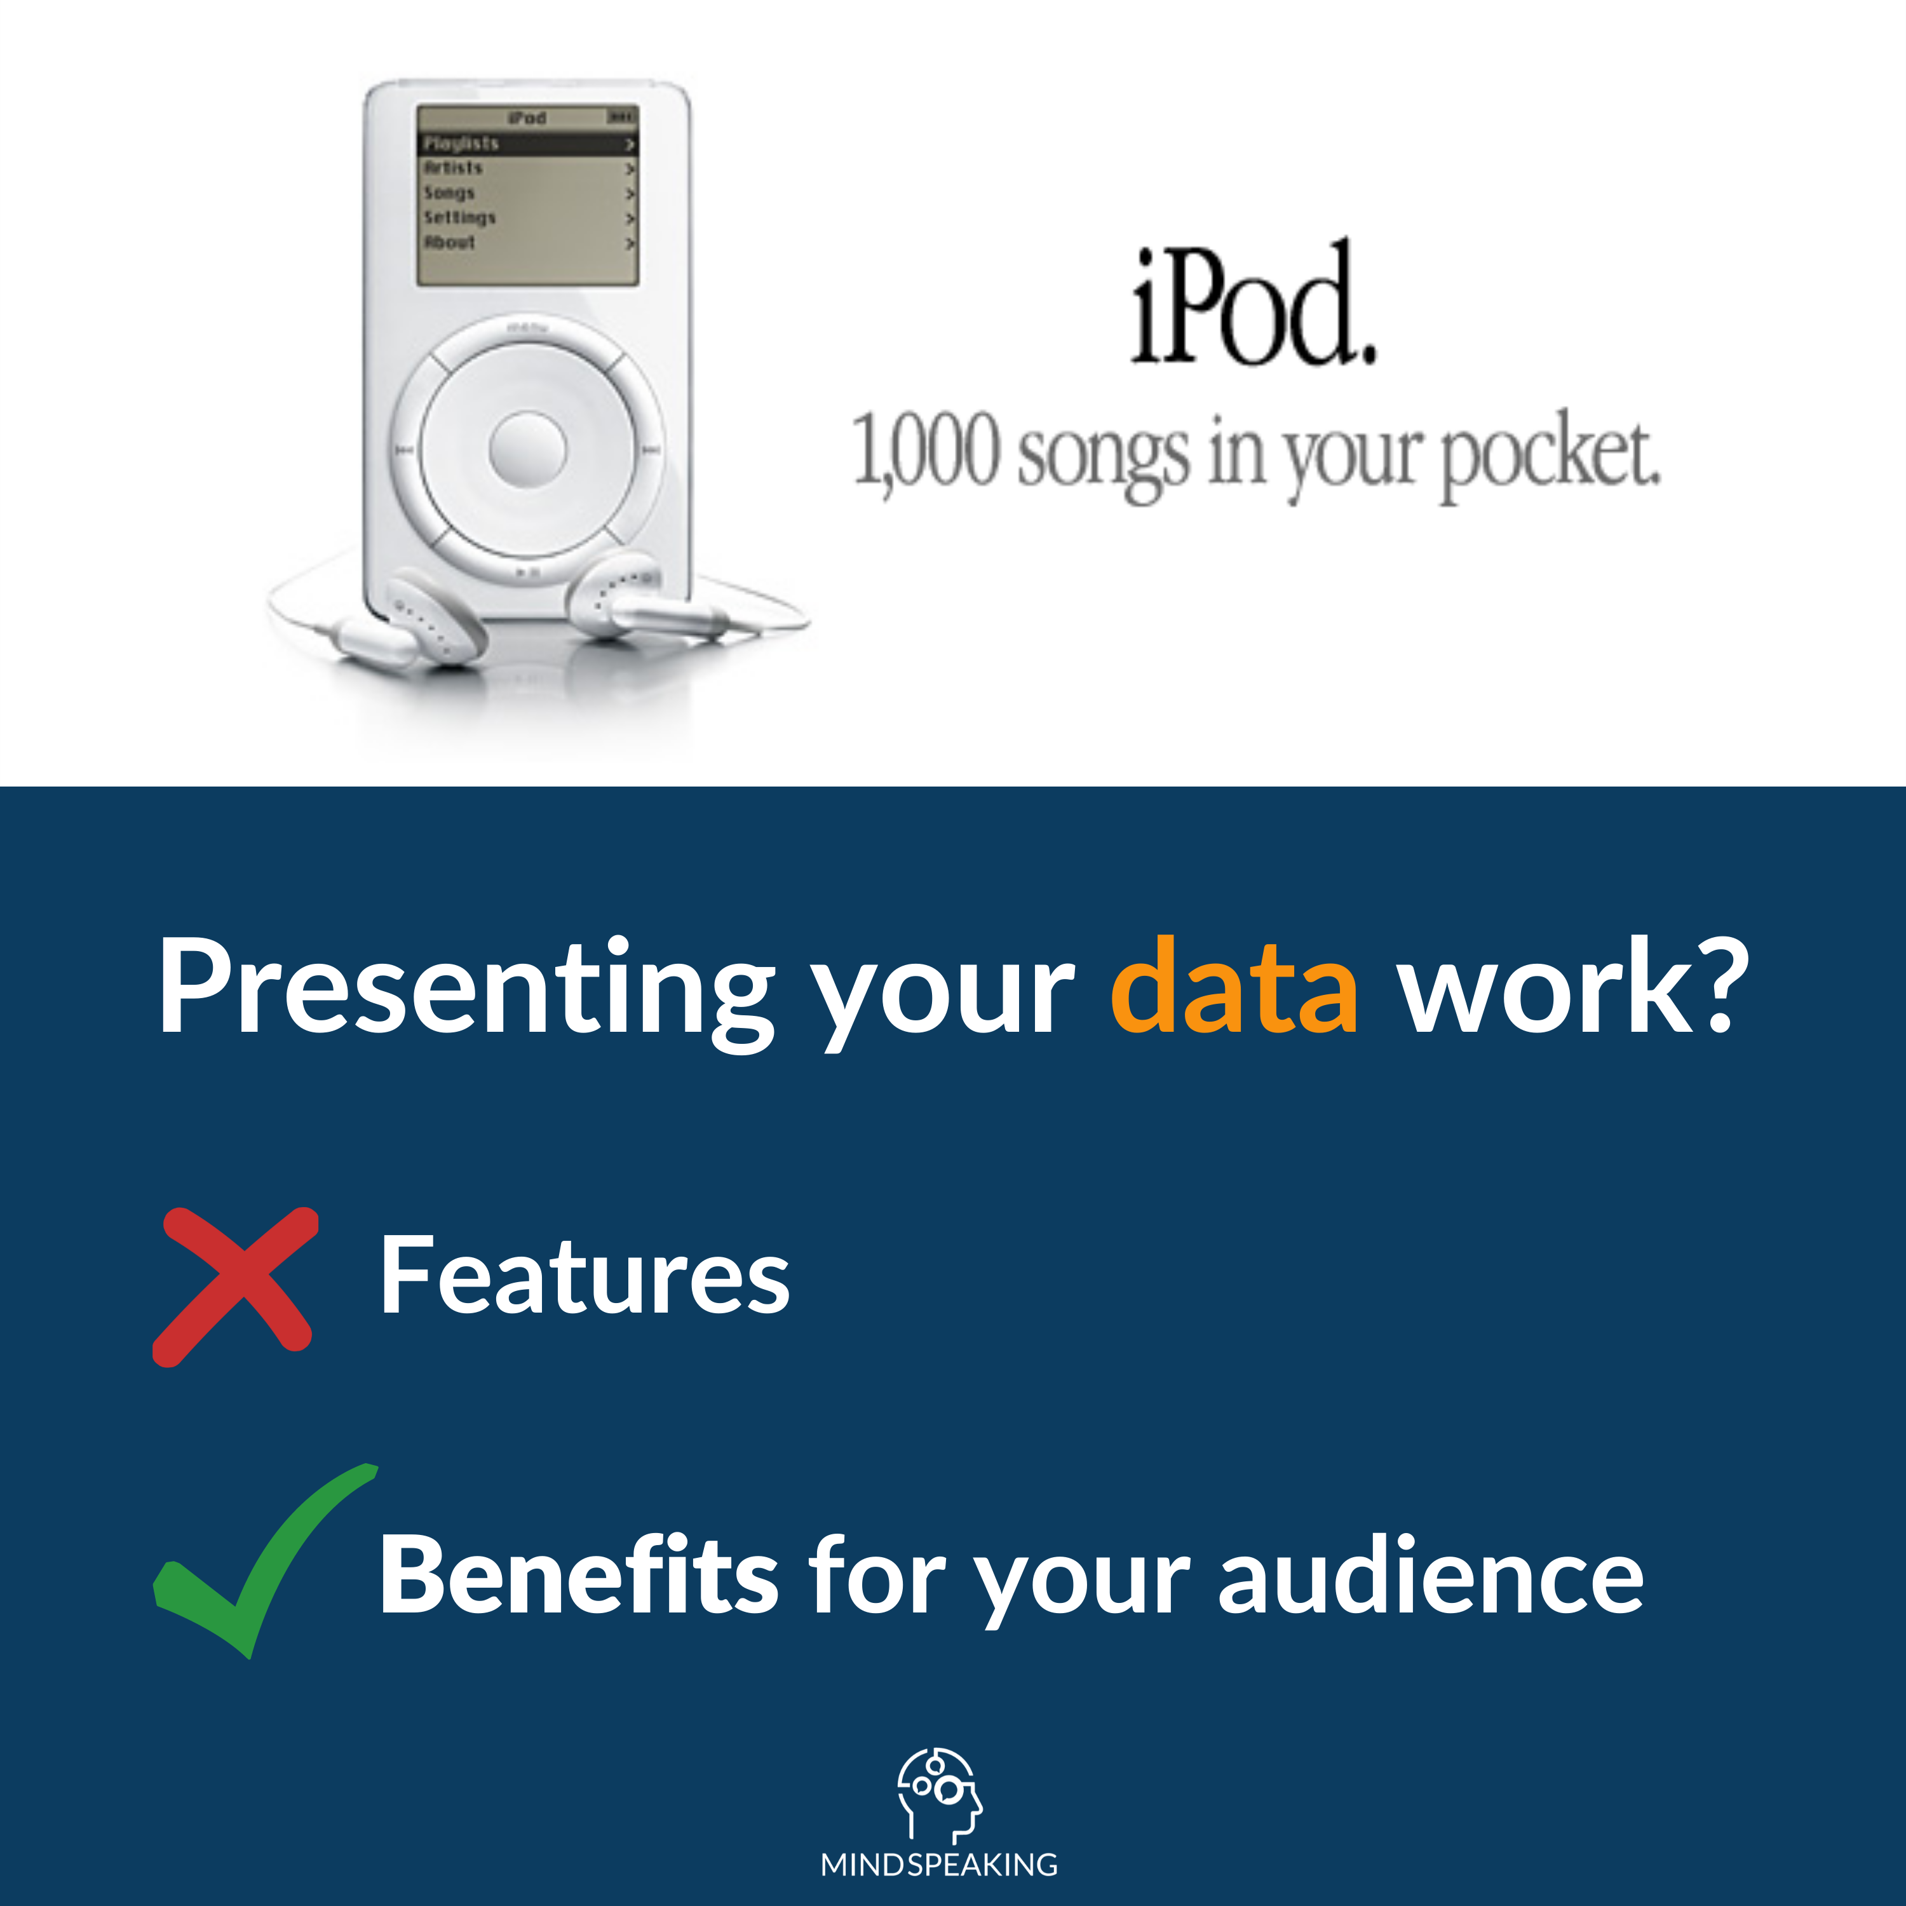
Notes:
Apple didn't make an ad that said: "3GB of storage." They made an ad that said: "1,000 songs in your pocket." Benefits over features. Apply this in your work as a Data Scientist or Analyst. For example:
When you speak to a Marketing Manager — DON'T: ❌ Focus on the technical features of your customer churn model. DO: ✅ Tell how it will help her increase customer loyalty. #analytics #datascience #datastorytelling

Slide 2
Notes:
Apple didn't make an ad that said: "3GB of storage." They made an ad that said: "1,000 songs in your pocket." Benefits over features. Apply this in your work as a Data Scientist or Analyst. For example:
When you speak to a Marketing Manager — DON'T: ❌ Focus on the technical features of your customer churn model. DO: ✅ Tell how it will help her increase customer loyalty. #analytics #datascience #datastorytelling

Slide 3
Notes:
Apple didn't make an ad that said: "3GB of storage." They made an ad that said: "1,000 songs in your pocket." Benefits over features. Apply this in your work as a Data Scientist or Analyst. For example:
When you speak to a Marketing Manager — DON'T: ❌ Focus on the technical features of your customer churn model. DO: ✅ Tell how it will help her increase customer loyalty. #analytics #datascience #datastorytelling

Slide 4
Notes:
Apple didn't make an ad that said: "3GB of storage." They made an ad that said: "1,000 songs in your pocket." Benefits over features. Apply this in your work as a Data Scientist or Analyst. For example:
When you speak to a Marketing Manager — DON'T: ❌ Focus on the technical features of your customer churn model. DO: ✅ Tell how it will help her increase customer loyalty. #analytics #datascience #datastorytelling

Slide 5
Example
When you speak to a Marketing Manager…
Notes:
Apple didn't make an ad that said: "3GB of storage." They made an ad that said: "1,000 songs in your pocket." Benefits over features. Apply this in your work as a Data Scientist or Analyst. For example:

Slide 6
Example
When you speak to a Marketing Manager…
DON’T: ❌ Focus on the technical features of your customer churn model.
DO: ✅ ….?
Notes:
Apple didn't make an ad that said: "3GB of storage." They made an ad that said: "1,000 songs in your pocket." Benefits over features. Apply this in your work as a Data Scientist or Analyst. For example:

Slide 7
Example
When you speak to a Marketing Manager…
DON’T: ❌ Focus on the technical features of your customer churn model.
DO: ✅ Tell how your solution helps her increase customer loyalty.
Notes:
Apple didn't make an ad that said: "3GB of storage." They made an ad that said: "1,000 songs in your pocket." Benefits over features. Apply this in your work as a Data Scientist or Analyst. For example:

